Slide 1
DESIGN AND IMPLEMENTATION OF A GPS ASSISTED PRECISION BANANA PLANTING
Geospatial Analysis of Banana Planting Coordinates in Fountain University
Junaid Sekinat– FUOCV240033
Department of Mathematical and Computer Science
Fountain University, Department of Computer Science, 2025

Slide 2
Background and Motivation
Importance of Banana and Plantain Farming
Banana and plantain are staple foods and important income sources in Nigeria.
They are rich in nutrients and consumed year-round by millions of people.
It is widely cultivated in the southwestern region, including Osun State.
Challenges in Traditional Planting
Most farmers plant without standard spacing, which reduces yield and plant health.
Without location records, it becomes hard to monitor or revisit specific plants.
Managing the field manually takes time, effort, and is often inaccurate.
The Role of Precision Agriculture
Precision farming uses tools like GPS to improve field management.
With GPS, farmers can accurately measure spacing and track each plant's location.
This makes it easier to monitor growth, detect problems early, and increase productivity.
Fountain University, Department of Computer Science, 2025

Slide 3
Objectives of the Study
To assess how banana plants are spaced and how they are growing, using GPS data.
To compare the growth performance of different banana varieties; Plantain and Cavendish.
To find out which spacing ranges are most likely to result in healthy plant growth.
To visualize the entire plantation on a map and identify any patterns or problem areas.
Fountain University, Department of Computer Science, 2025

Slide 4
Dataset Overview
The analysis was carried out using tools like:
  Python
  Pandas for data handling
  Geopy for calculating spacing
  Seaborn for charts
  Folium for interactive map visualization
The dataset contains a total of 71 banana plants, each with detailed records.
Each plant has a unique Plant ID, along with its GPS coordinates (latitude and longitude).
The Plant Variety is recorded as either Plantain or Cavendish.
The Growth Status is categorized as Healthy, Wilting, or Stunted.
A Spacing column was calculated using GPS data to measure the distance between each plant and its closest neighbor.
Fountain University, Department of Computer Science, 2025

Slide 5
Preprocessing Steps
The dataset was carefully checked to clean any missing or inconsistent values.
After preprocessing, the cleaned dataset was saved and made ready for analysis.
A new column was created to categorize spacing into:
Below 2 meters
2 to 4 meters
Above 4 meters
The spacing between each plant and its nearest neighbor was calculated using GPS coordinates with the help of the Geopy library.
Fountain University, Department of Computer Science, 2025

Slide 6
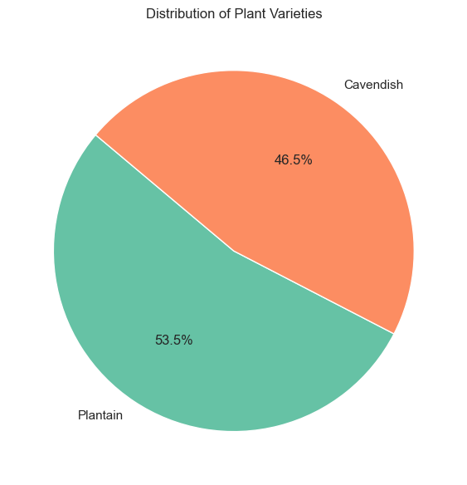
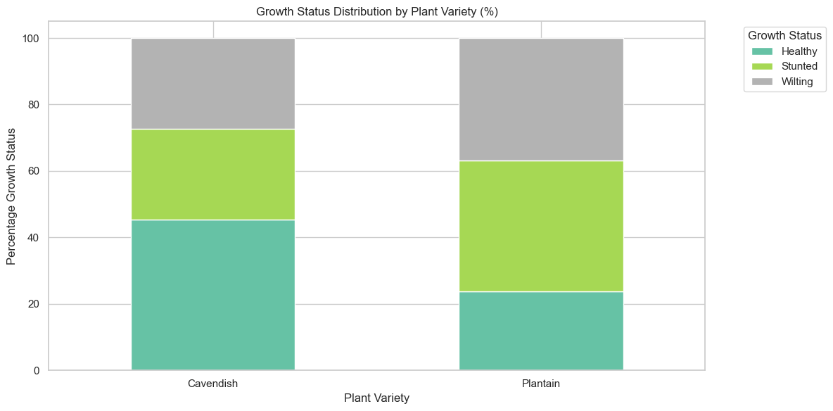
Growth Status and Variety Performance
Plantain makes up 53.5% of all plants
Cavendish makes up 46.5%
Cavendish had more healthy plants, with 45.5% recorded as healthy
Plantain showed higher rates of stunted (39.5%) and wilting (36.8%) growth
Fountain University, Department of Computer Science, 2025

Slide 7
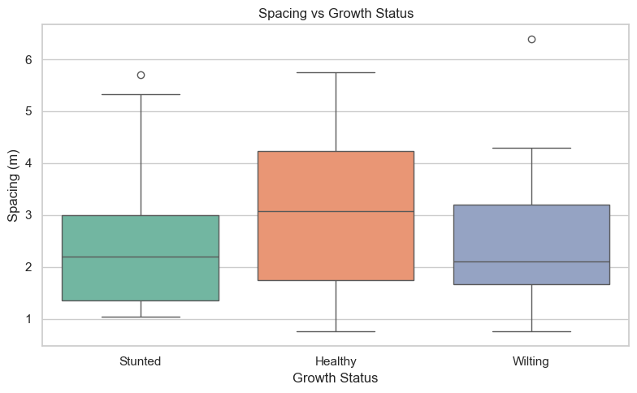
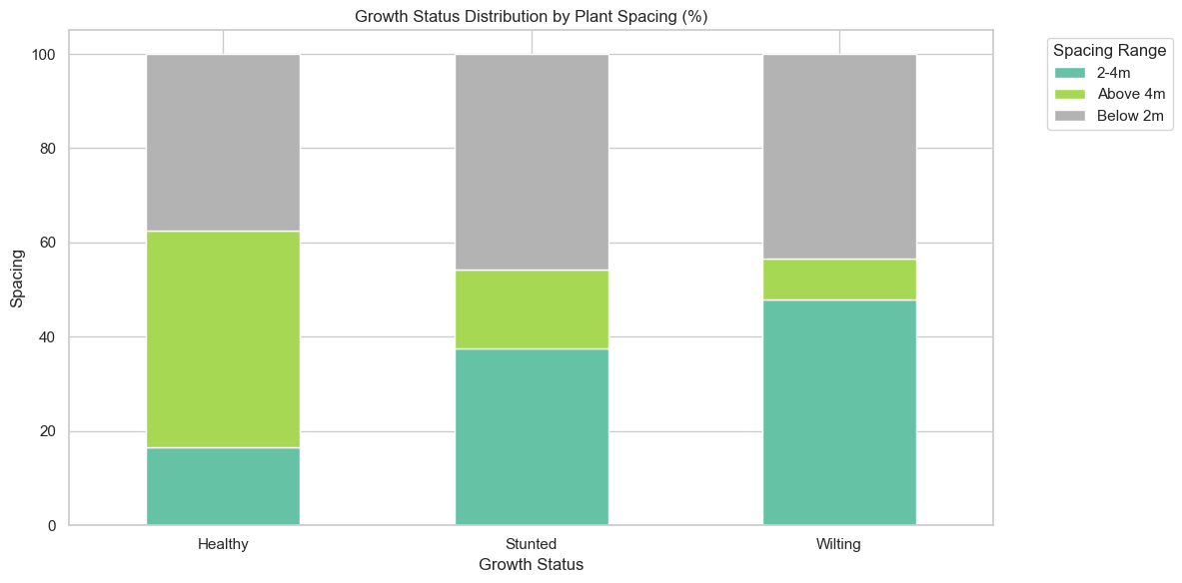
Effect of Spacing on Plant Growth
Healthy plants had a median spacing of about 3.08 meters
Stunted and wilting plants were generally found at closer spacing, below 2 meters
When spacing was above 4 meters, 45.8% of the plants were healthy
Tightly spaced plants (below 2 meters) had the highest rates of poor growth
Fountain University, Department of Computer Science, 2025

Slide 8
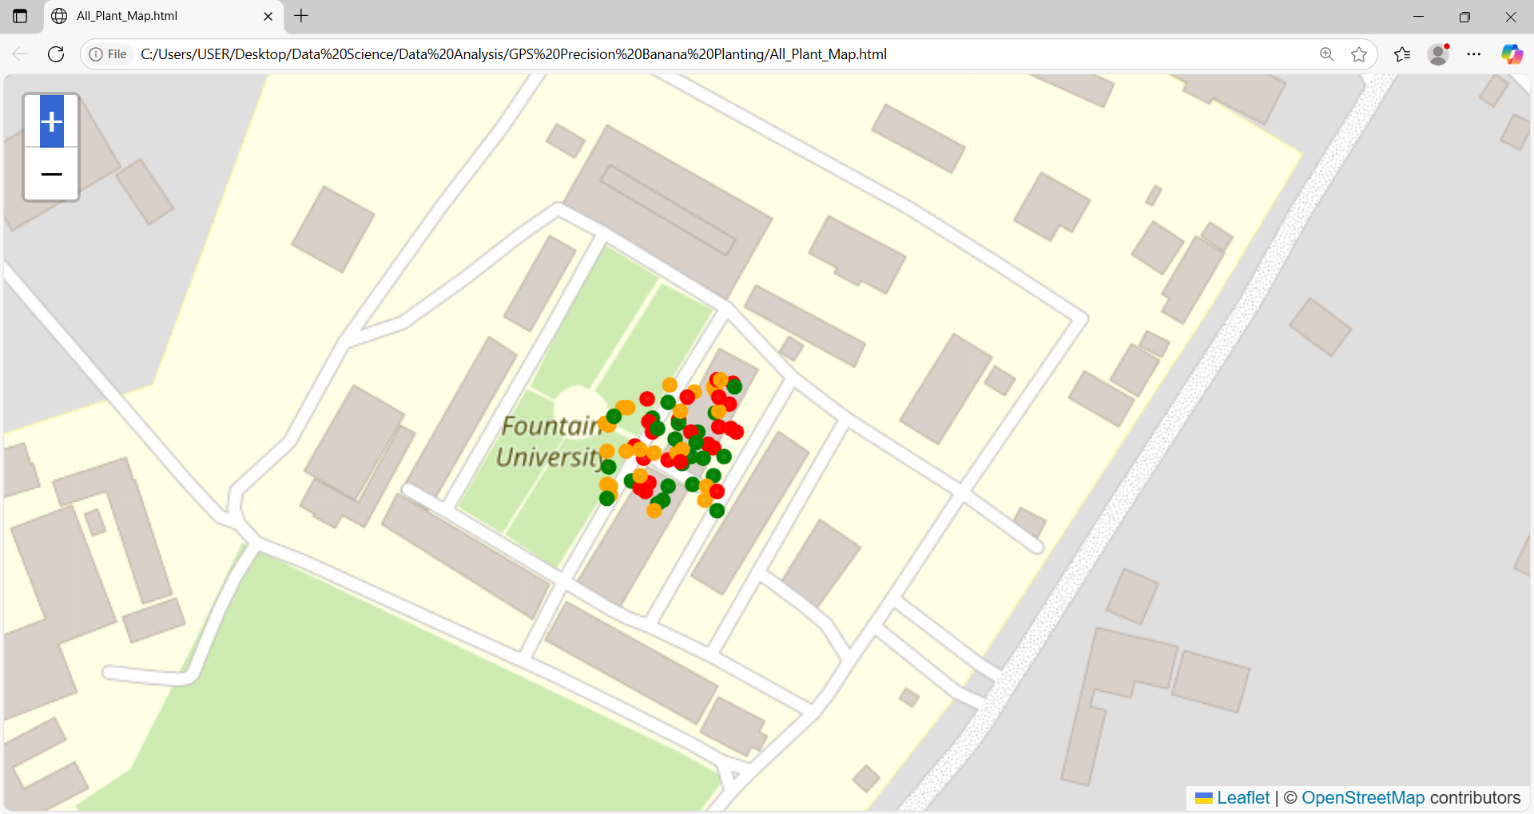
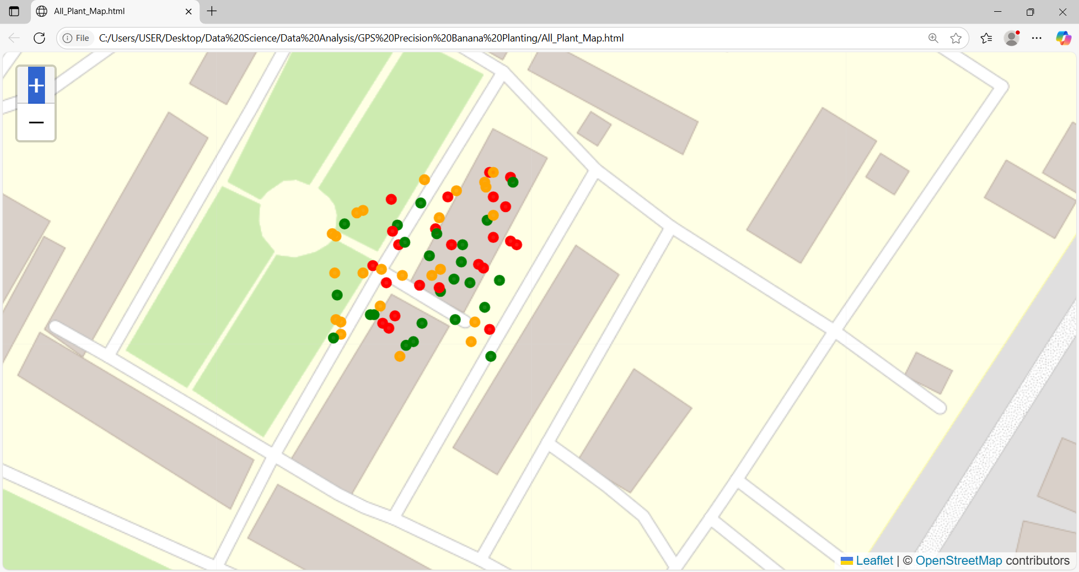
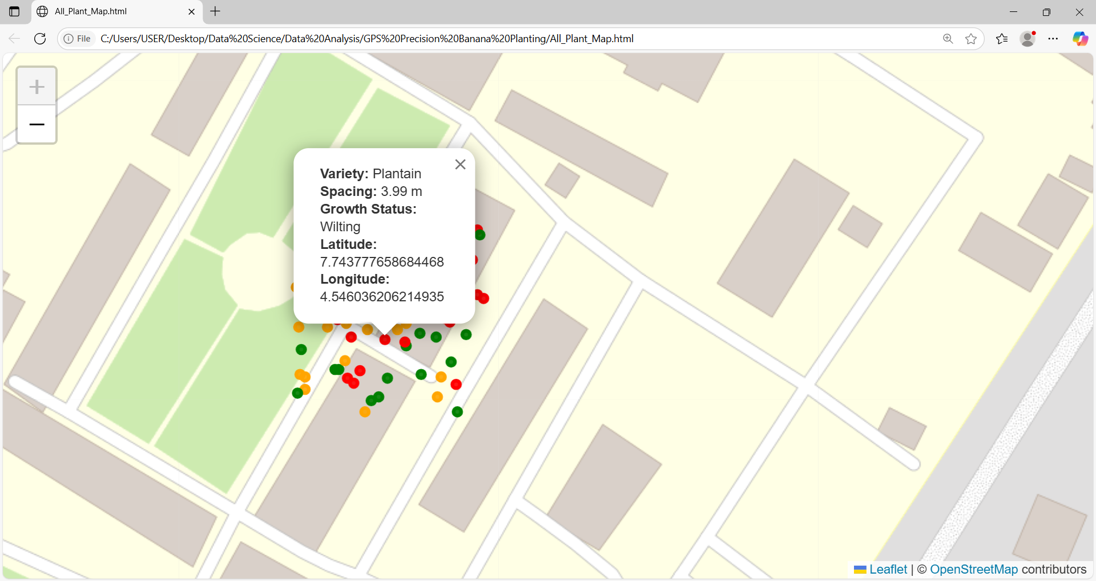
Interactive Field Visualization
What the Map Shows:
Each plant is marked on an interactive Folium map using its GPS coordinates.
Marker colors represent plant health:
  🟢 Green for Healthy
  🟠 Orange for Stunted
  🔴 Red for Wilting
Clicking on a marker reveals plant details like:
Variety
Spacing
Growth Status
Latitude & Longitude
Fountain University, Department of Computer Science, 2025

Slide 9
Key Findings and Takeaways
Plants that were spaced too closely together (especially below 2 meters) were more likely to be stunted or wilting.
The Cavendish variety showed better overall growth, with more healthy plants compared to Plantain.
Wider and more consistent spacing (above 4 meters) was linked to healthier plant growth.
Using GPS data made it easy to calculate spacing and track individual plants in the field.
With the map, farmers can locate any plant instantly by its coordinates, this makes it easier to check, treat, or replant specific plants when needed.
Fountain University, Department of Computer Science, 2025

Slide 10
Conclusion & Future Work
This project showed how GPS-assisted planting can help monitor and improve banana plantation layout and growth.
We found that plant spacing and variety choice play a major role in plant health and performance.
In the future, this kind of analysis can be expanded by including:
Soil moisture readings
Planting depth sensors
Drone mapping for large-scale field monitoring
The approach used here can be applied in real-world banana farms to guide planting decisions, reduce crowding, and improve yields.
Fountain University, Department of Computer Science, 2025

Slide 11
Thank you for listening!
Fountain University, Department of Computer Science, 2025

